Slide 1



VISUALIZATION
Knowledge and solutions for a changing world
Advancing data-intensive discovery in all fields
Be boundless
UW DIRECT
(Data Intensive Research Enabling Cutting-edge Tech)
https://uwdirect.github.io
Stéphanie Valleau
Chemical Engineering

Slide 2
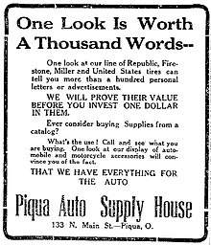
Why?
A good graph enables you to
Capture your audience’s attention
Explain your data clearly
Show what is important in your data
Scientific accuracy
Readability
Showmanship
https://en.wikipedia.org/wiki/A_picture_is_worth_a_thousand_words

Slide 3
What makes a good plot?
Let’s have a look at some bad plots and see what matters the most to make a good plot

Slide 4
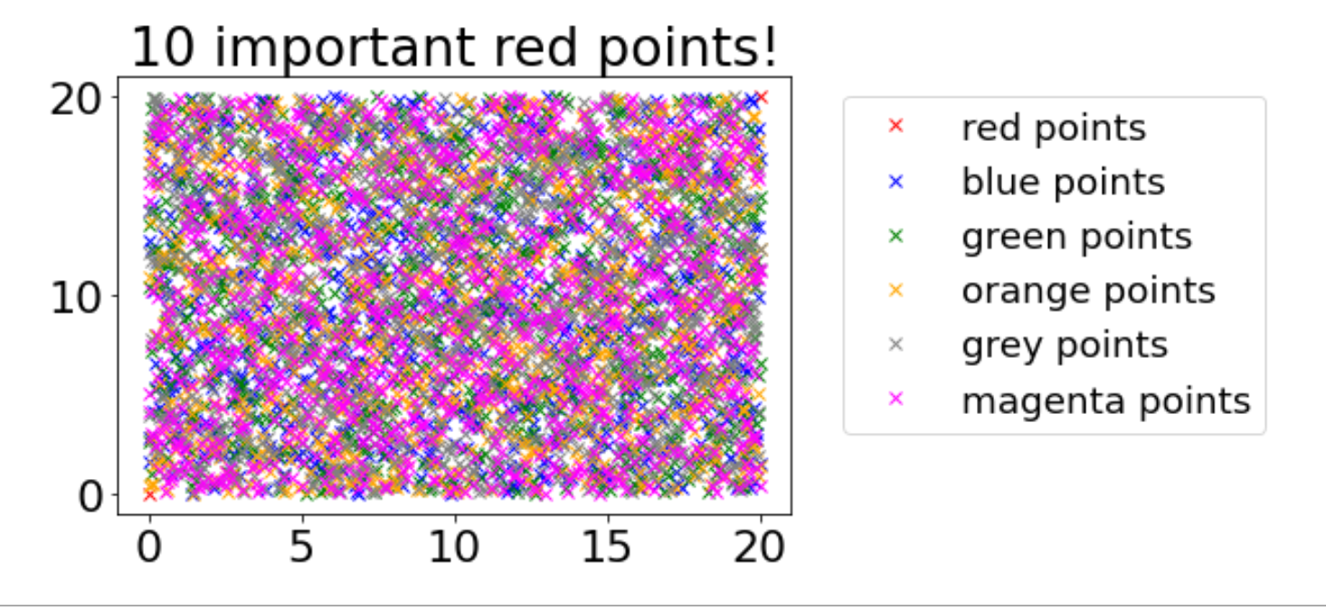

What is wrong here?
List all the aspects you believe are bad/missing in this plot

Slide 5
Some of the issues
Can’t see the red points! (readability)
Why are we seeing all the other points if they don’t matter? (readability / scientific accuracy / showmanship)
I can’t distinguish the colors – colorblind (readability / showmanship)
The markers are all the same (readability / showmanship)
Why are we plotting this? What does the data represent?
Scientific accuracy
Readability
Showmanship

Slide 6
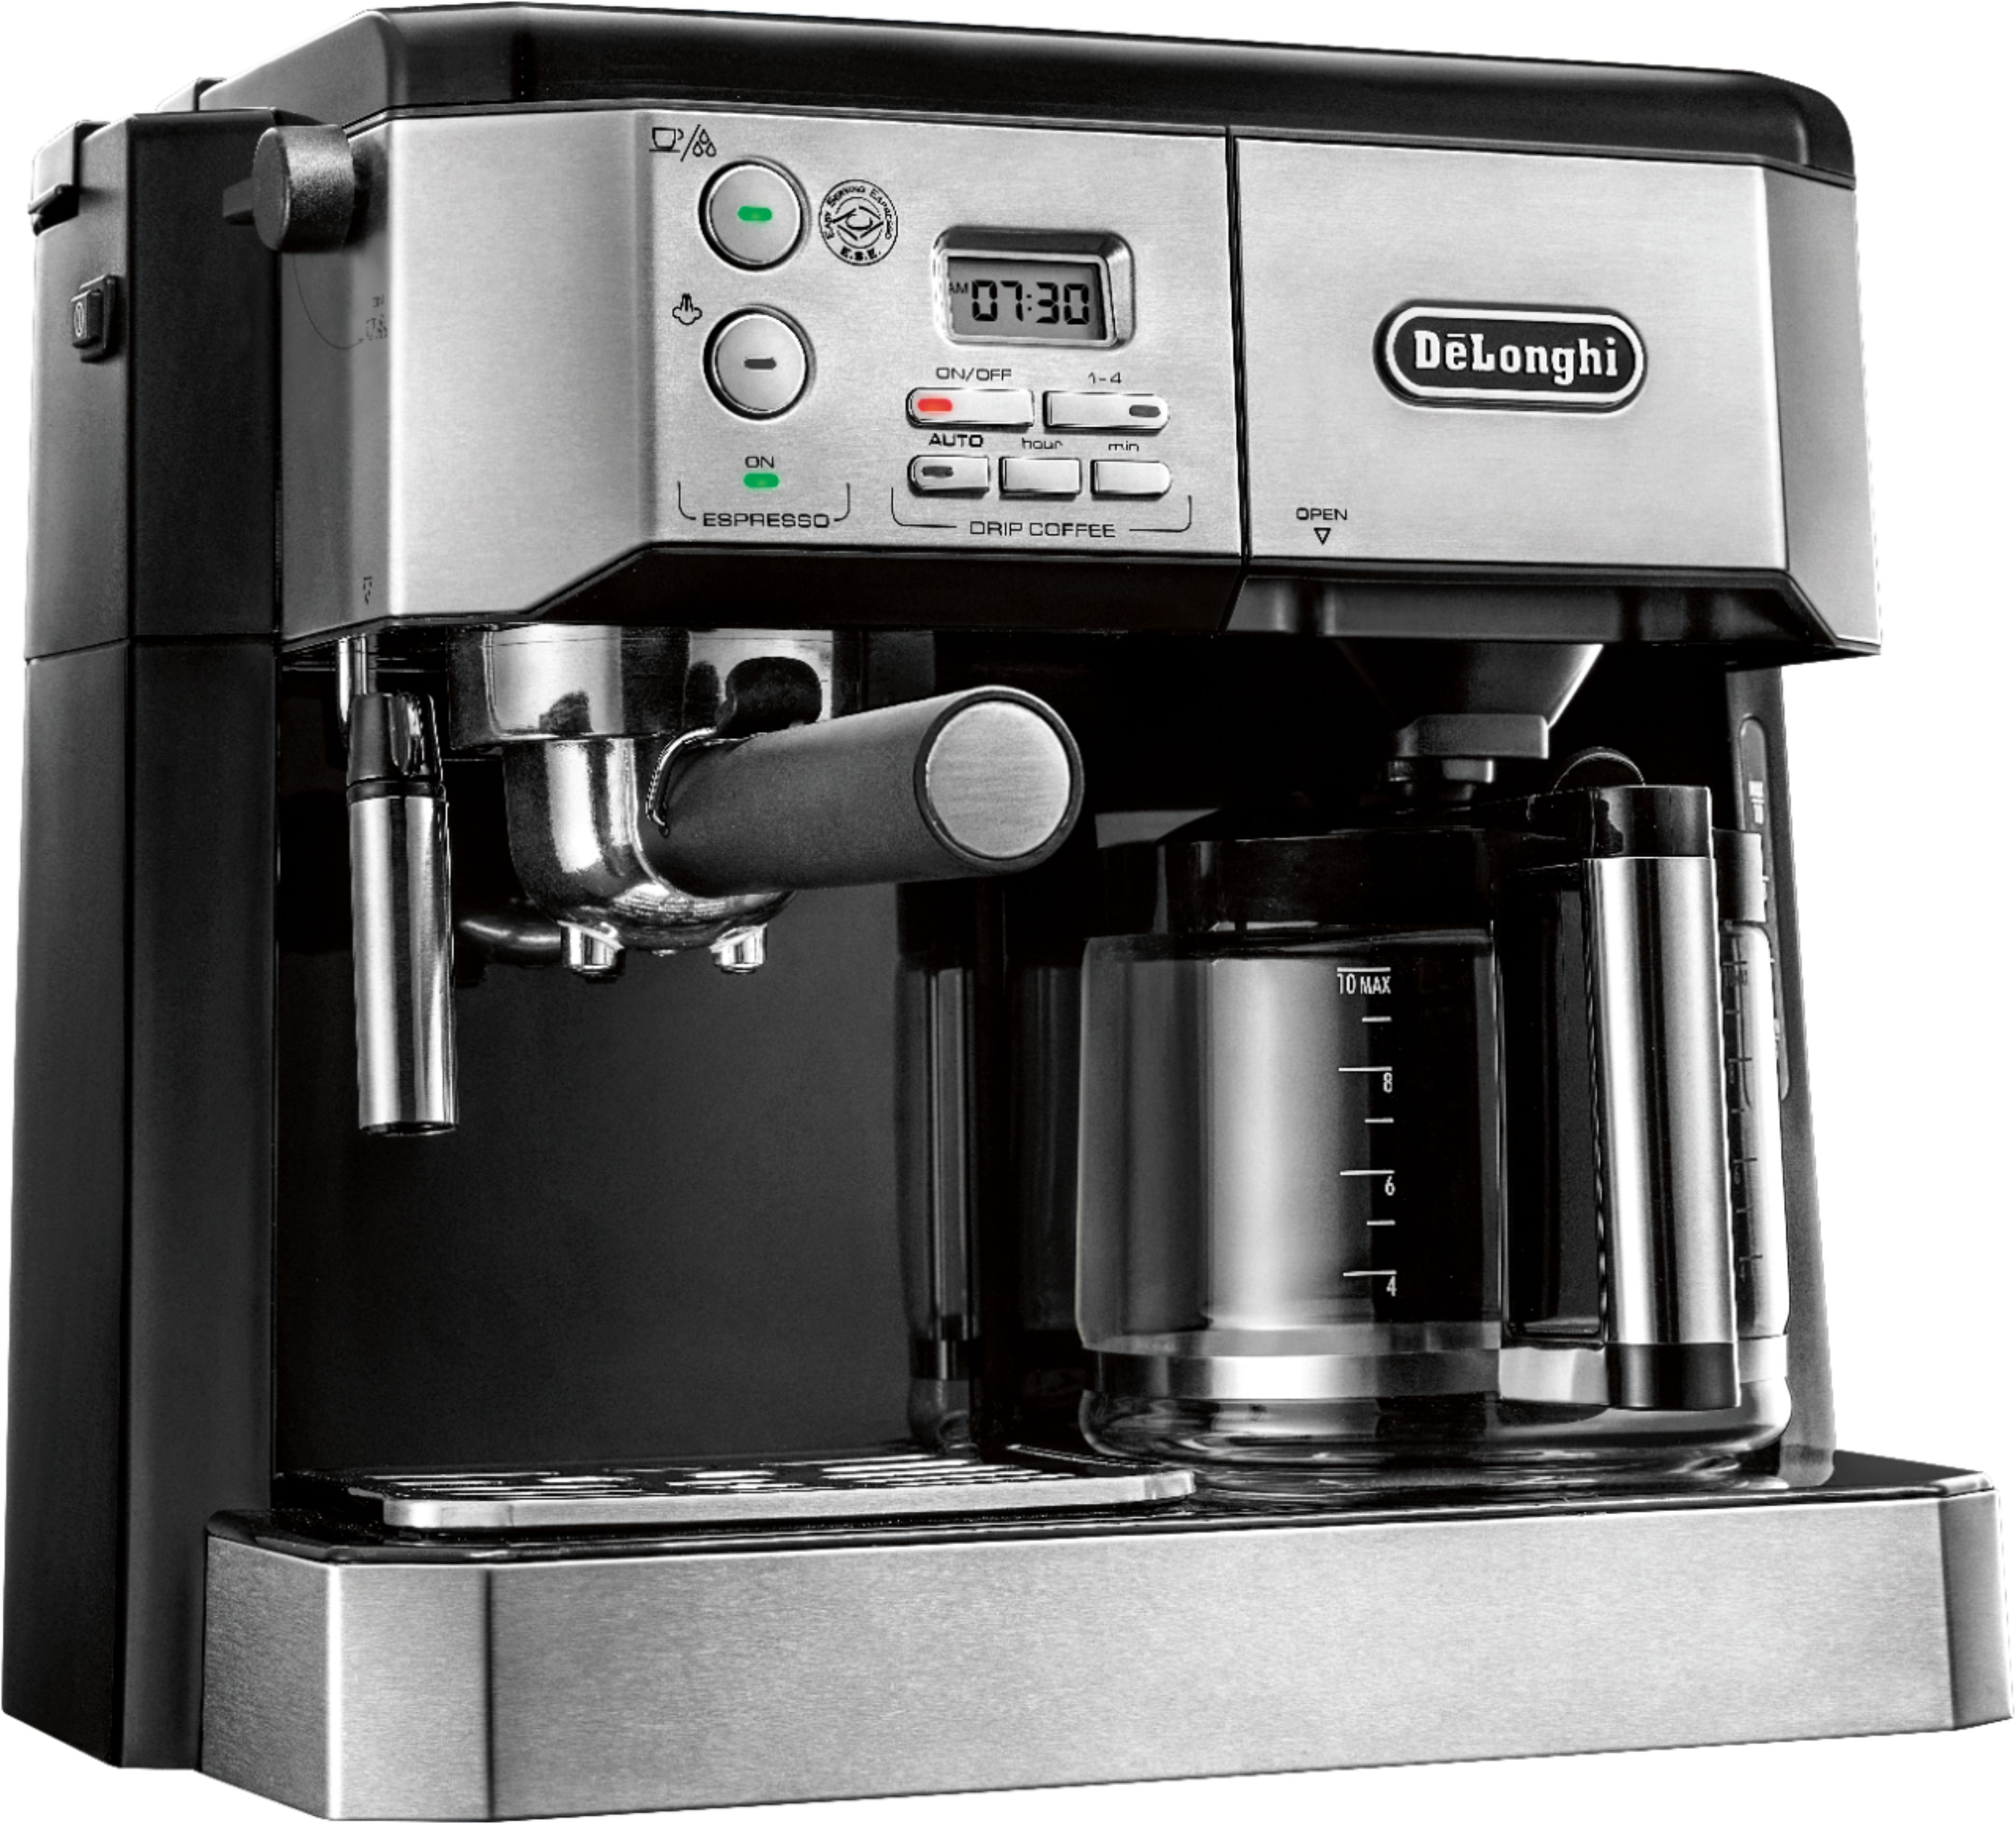
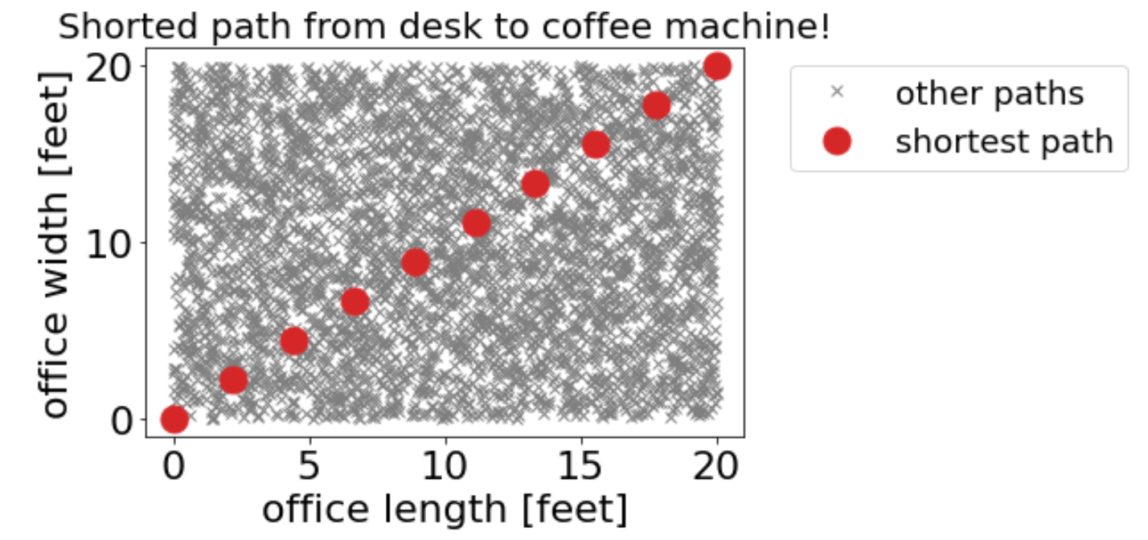
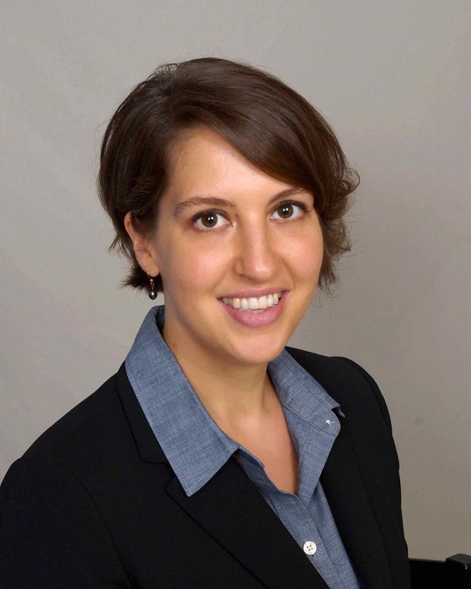
Fixed plot

Slide 7
Open Jupyter notebook
Let’s see how to make these plots using matplotlib
Open the L2_Visualization.ipynb notebook
curl –O https://raw.githubusercontent.com/UWDIRECT/UWDIRECT.github.io/master/Wi21_content/DSMCER/L2_Visualization.ipynb

Slide 8
What is wrong with these plots?
https://blog.funnel.io/why-we-dont-use-pie-charts-and-some-tips-on-better-data-visualizations

Slide 9
Some of the issues
Hard to make comparison between each slice (readability / scientific accuracy / showmanship)
Plot is shown at an angle (readability / scientific accuracy)
Unclear goal ( scientific accuracy / showmanship)
Wrong type of plot (showmanship)

Slide 10
Fixed plot
PS: Still not great … was made in excel ;)

Slide 11
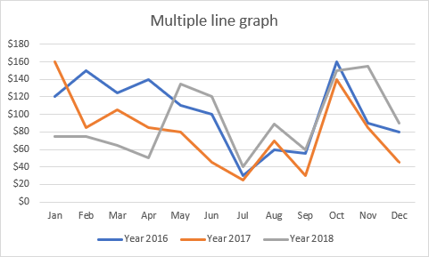
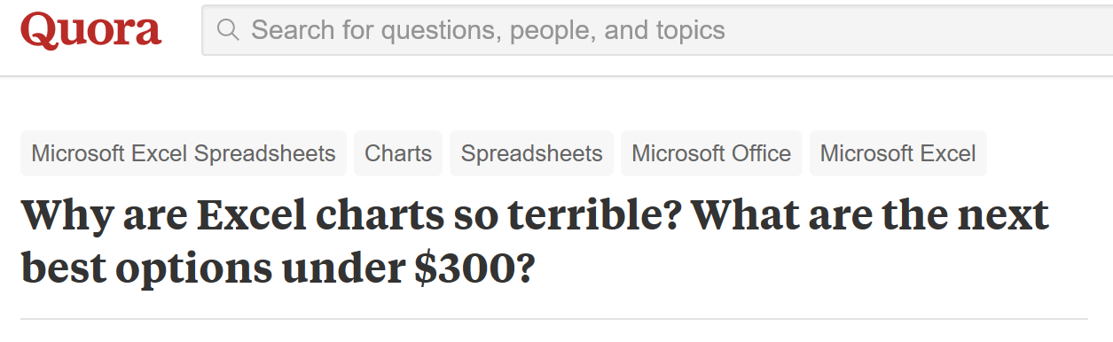
Learning by unexample
If you are still an excel fan …
Notes:
I don’t want this to come off as a polemic against Excel, but I do.
Pull out an Excel spreadsheet and talk about differences.
Ultimately, Excel only suffers from some dreary default behavior that can make meetings horrible after you’ve seen enough bad graphs in a bad Powerpoint presentation.
And limited default visualizations.

Slide 12
Learning by unexample

Slide 13
Learning by unexample
Coronal mass ejection
Amari et al. Nature (Wired best vis of 2014)

Slide 14



How to make a good plot?
We saw one example with matplotlib

Slide 15
Basic principles
Know your audience
What are the expectations?
Error bars?
Units?
Axis labels?
Are they experts?
https://www.informationisbeautifulawards.com/news/118-the-nyt-s-best-data-visualizations-of-the-year

Slide 16
Basic principles
Know your message
What exactly are you trying to convey – your goal?
How does it fit into the narrative of your presentation, manuscript, etc.?
When do you make figures for a manuscript?

Slide 17
Basic principles
Know your medium
Is your medium static (poster / presentation … ) ?
What colors does it support? Backlighting?
Does it support 3D?
What about 4D?
Whole poster infographic?

Slide 18
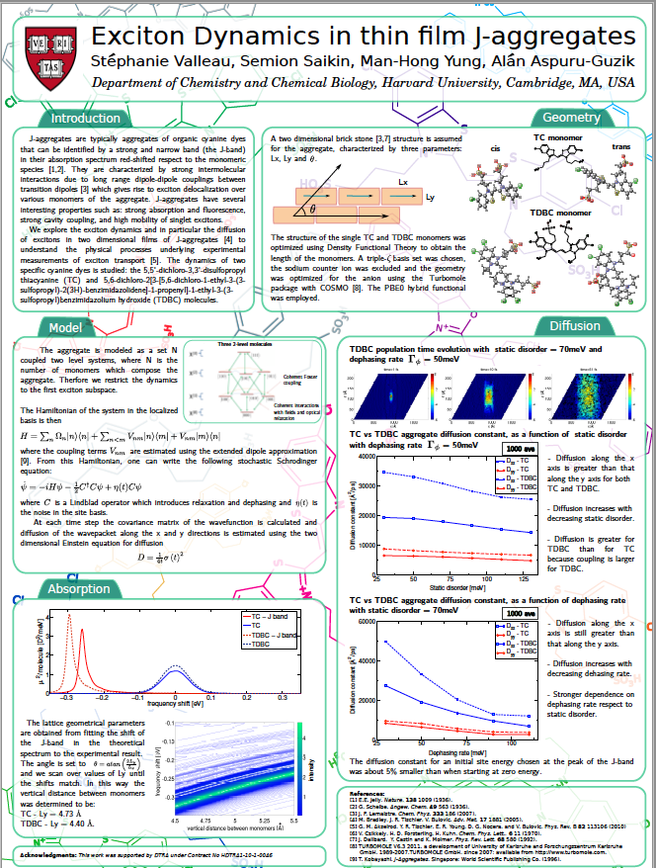
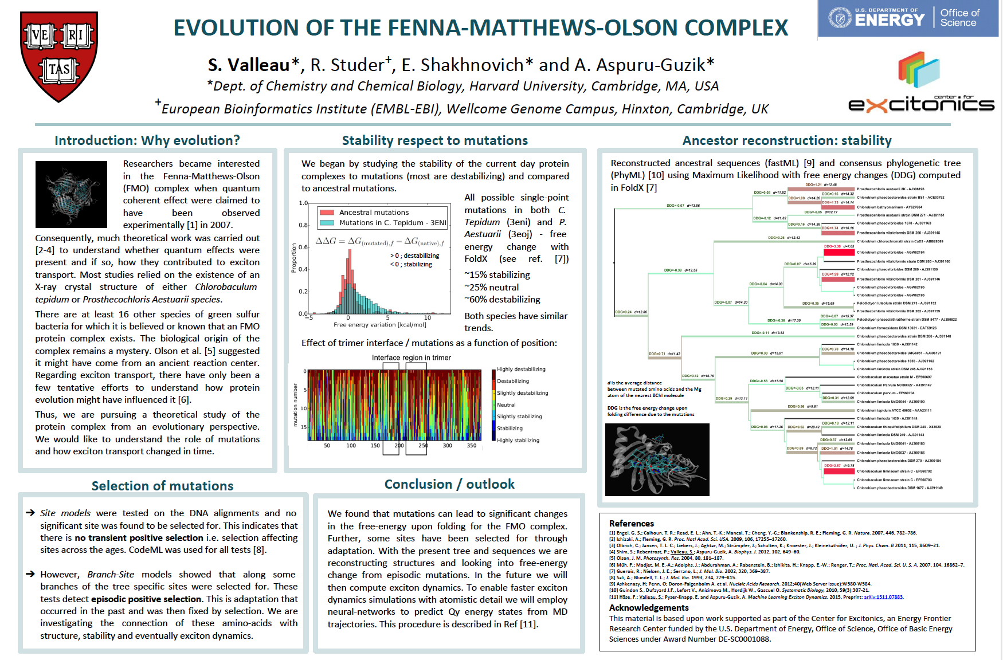
It takes time …
1st year of my PhD
Last year of my PhD

Slide 19
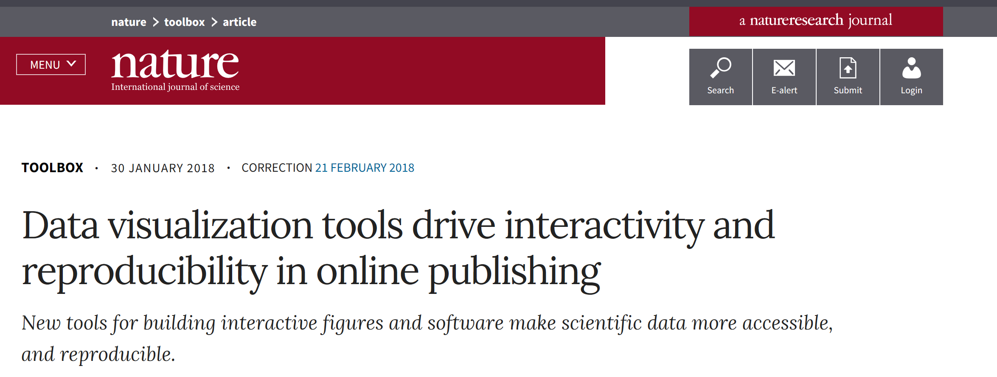
Basic principles
https://bokeh.pydata.org/en/latest/docs/gallery.html#gallery
https://altair-viz.github.io/gallery/index.html
Notes:
https://www.nature.com/articles/d41586-018-01322-9

Slide 20
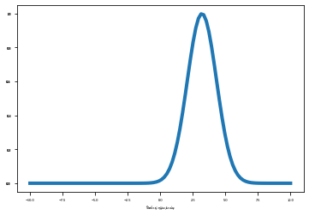
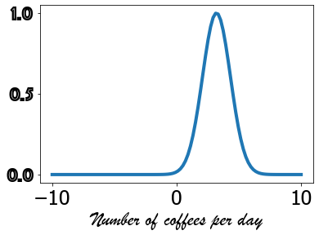
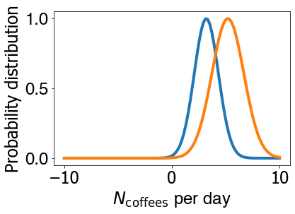
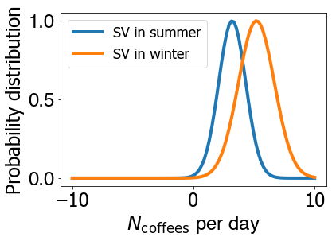
Basic principles: Text
Text isn’t optional
Font size
Font type
Axis labels
Legends
Caption
Fig.1: Distributions showing number of cups of coffee Dr. SV drinks per day in summer (blue line) and winter (orange line).

Slide 21
Basic principles: Color
Color is important
Why?
What are you trying to accomplish with color?
Diverging vs. sequential
Perceptually uniform colormaps
Viridis
Click this link:
http://colorbrewer2.org

Slide 22
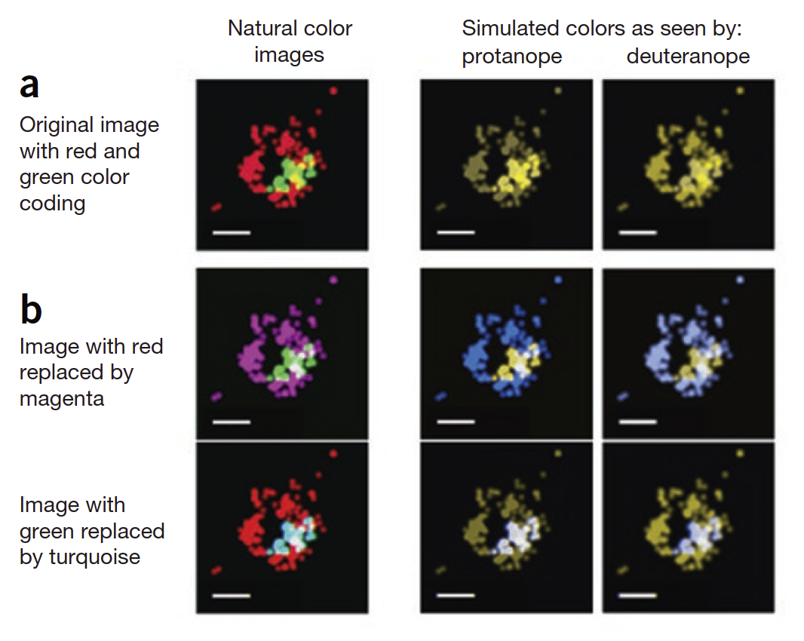
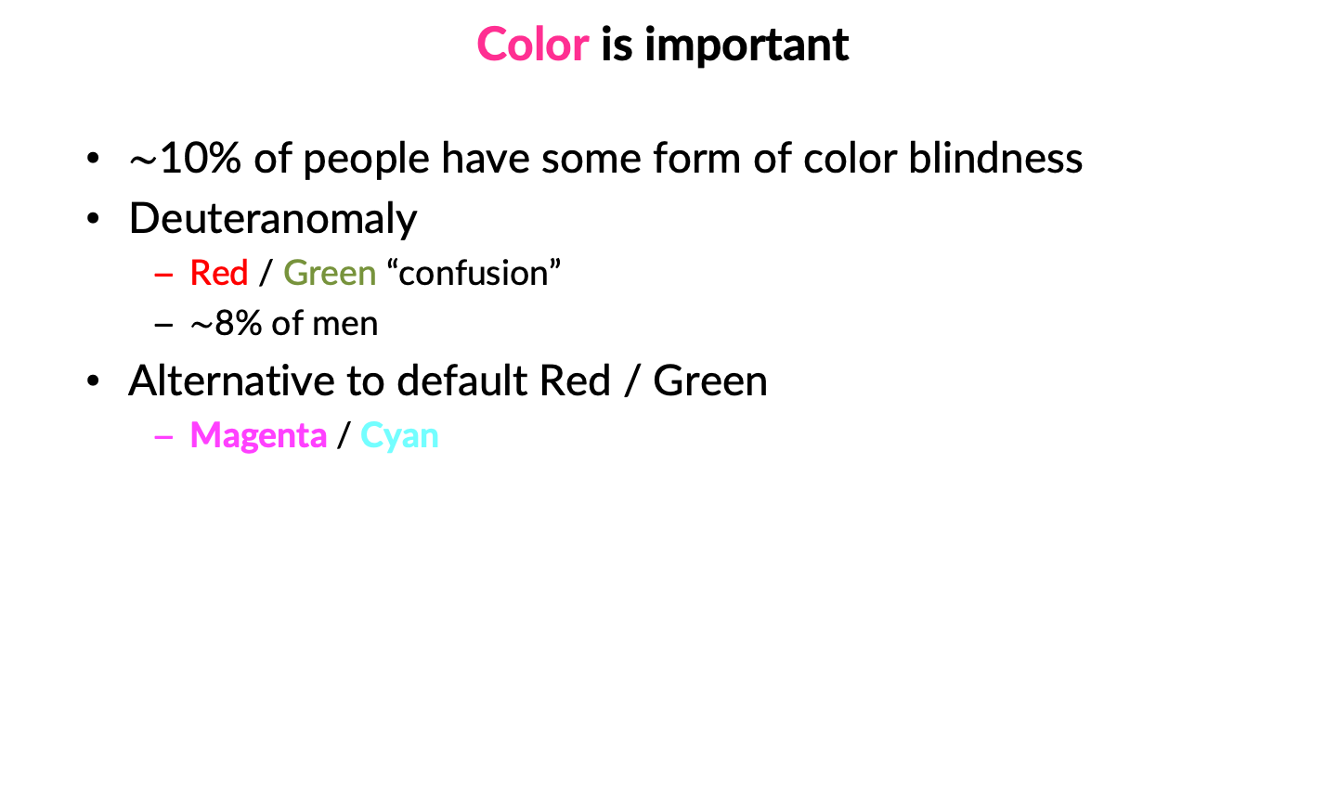
Basic principles: Color
Color is important
$\sim$10% of people have some form of color blindness
Deuteranomaly
Red / Green “confusion”
$\sim$8% of men
Alternative to default Red / Green
Magenta / Cyan

Slide 23
Basic principles: Color
3D STORM (stochastic optical reconstruction microscopy) images of CCPs and transferrin in live cells
Wong, B. Points of view: Color blindness. Nat Methods 8, 441 (2011). https://doi.org/10.1038/nmeth.1618

Slide 24
Basic principles: Honesty
Do no evil
There is a fine line between changing a visualization to show a scientific conclusion and implying a scientific conclusion by changing a visualization
http://journals.plos.org/ploscompbiol/article?id=10.1371/journal.pcbi.1003833

Slide 25
Basic principles
Avoid chartjunk (taken from PLOS article)
http://journals.plos.org/ploscompbiol/article?id=10.1371/journal.pcbi.1003833

Slide 26

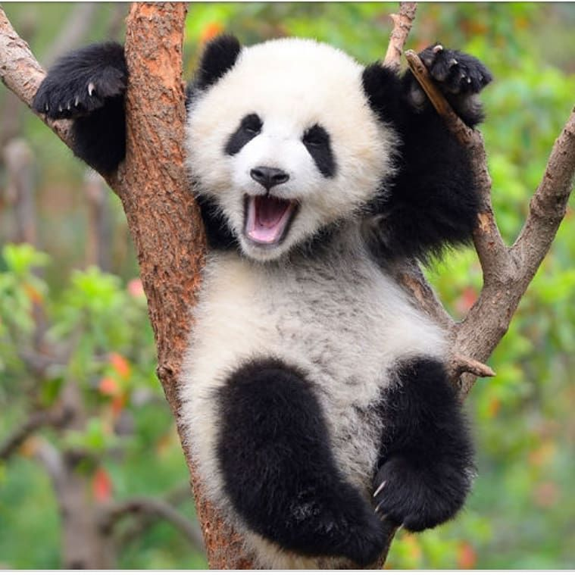
Next time - Pandas

